Slide 1
Angular Bootcamp Introduction Angular Part 1
10-10-2020
Notes:
https://medium.com/front-end-weekly/typescript-class-vs-interface-99c0ae1c2136

Slide 2
Sunday 18 oct. (4.5 Hrs)
1. Angular Introduction 11:30 – 12:00
- Exercise: Create Angular Project 12:00 - 12:30
2. Angular Project structure 12:30 – 12:45
- Exercise: Configure Project 12:45 – 13:15
3. Routing to Component 13:15 – 13:30
- Exercise: Create component & routing 13:30 – 14:00
4. Databinding 14:00 – 14:15
- Exercise: databinding 14:15 – 14:45
5. Event Binding 14:45 – 15:00
- Exercise: events 15:00 – 15:30
6. Output Events 15:30 – 15:45
- Exercise: output events 15:45 – 16:00

Slide 3

1. Angular Intro
Angular 2 should be thought of as a platform

Slide 4
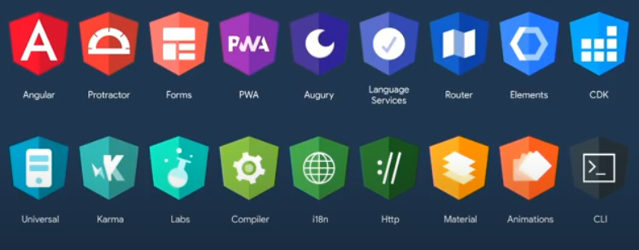
1. Angular Intro

Slide 5
1. Angular Intro

Slide 6
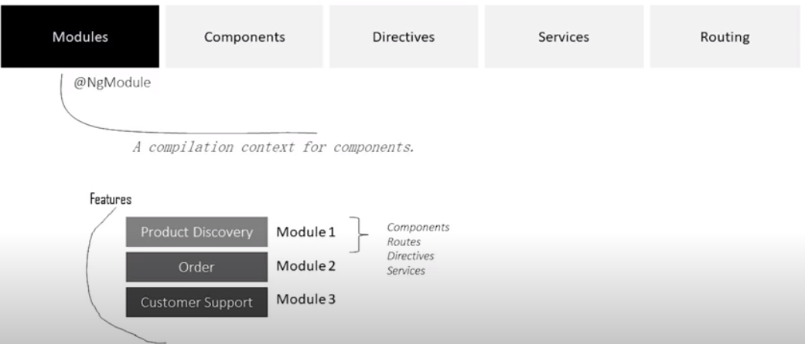
1. Angular Intro

Slide 7
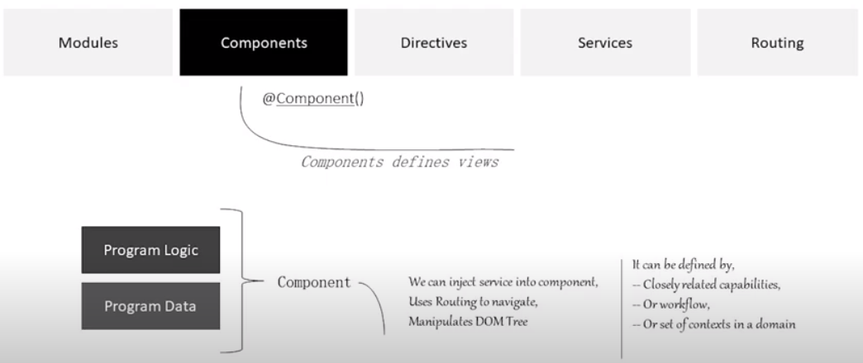
1. Angular Intro

Slide 8
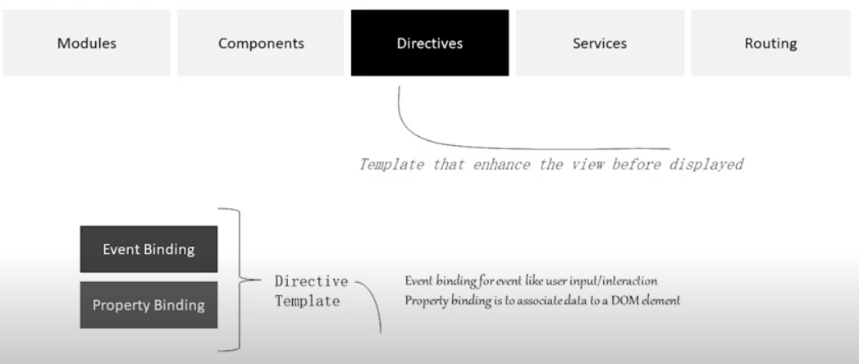
1. Angular Intro

Slide 9
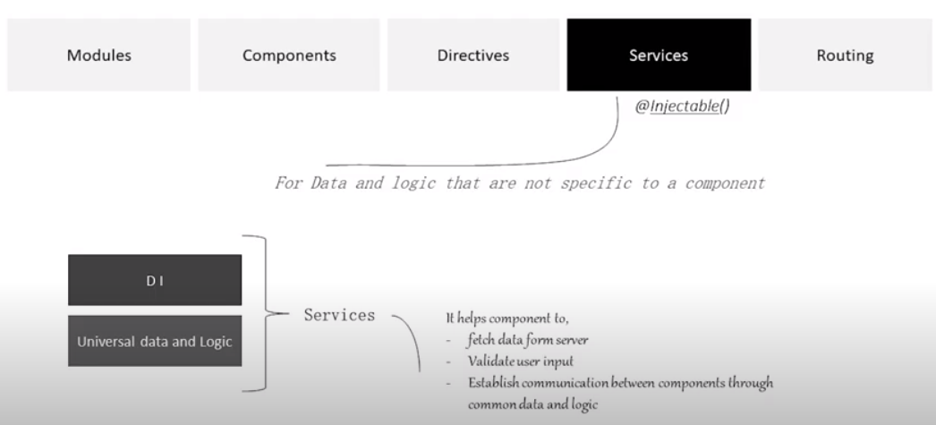
1. Angular Intro

Slide 10
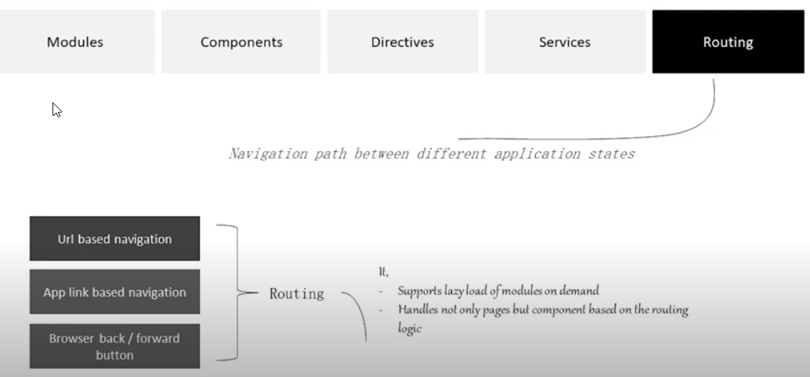
1. Angular Intro

Slide 11
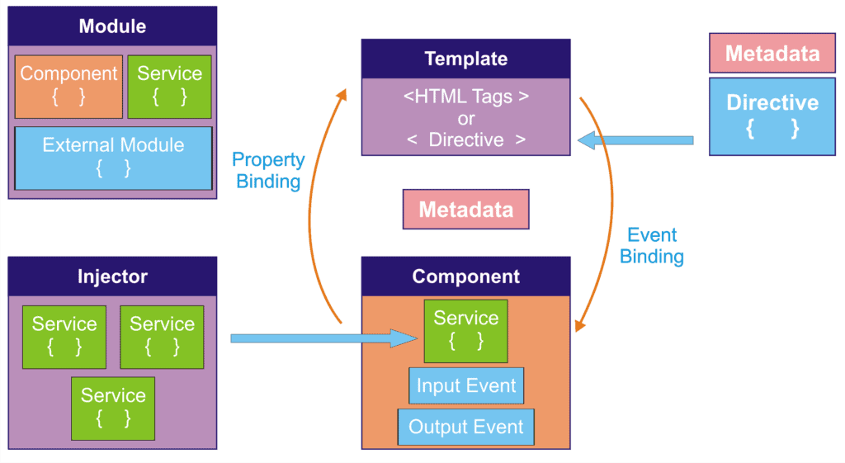
1. Angular Intro

Slide 12
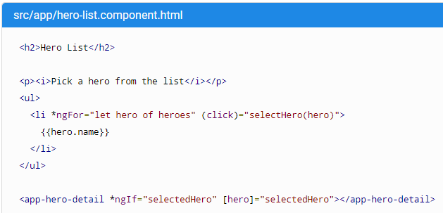
1. Angular Intro: Built-in Directives

Slide 13
1. Exercise: Create Angular Project
01_create_angular_project

Slide 14
2. Project Structure Overview
App.Module
App-Routing.Module
environments
angular.json
tslint.json
Folder structure

Slide 15
2. Exercise: Configure Project
02_configure_project

Slide 16
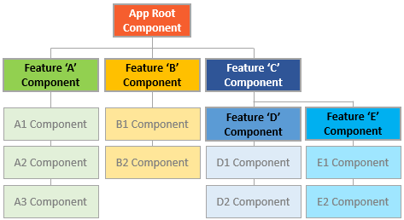
3. Routing to Components

Slide 17
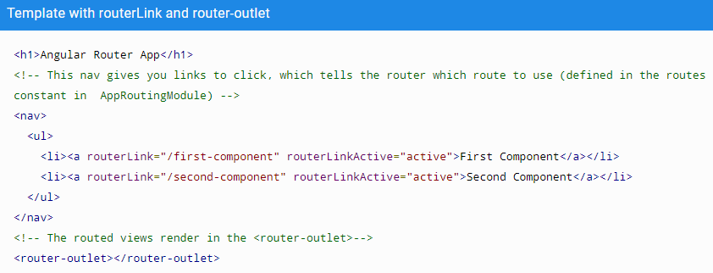
3. Routing to Components
Define router outlet in app.component.html

Slide 18
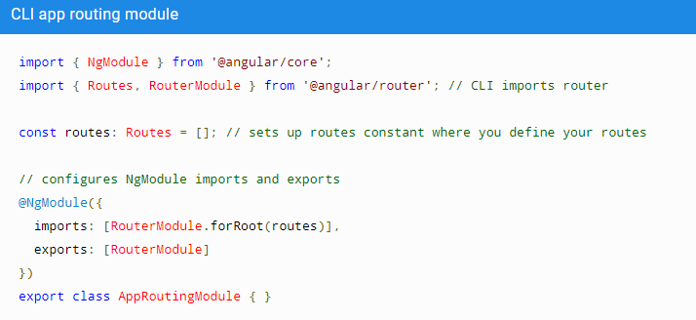
3. Routing to Components
AppModule Routing

Slide 19
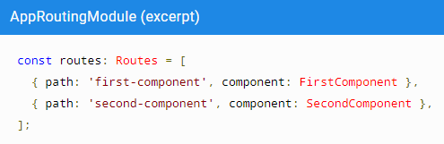
3. Routing to Components
Component Routing

Slide 20
3. Routing to Components
03_routing_to__page_component

Slide 21
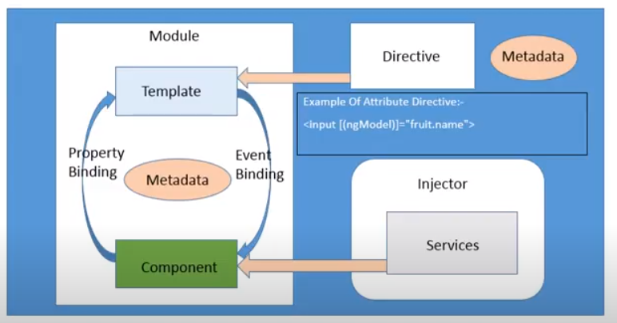
4. Data binding

Slide 22
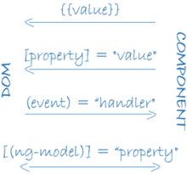
4. Data binding

Slide 23
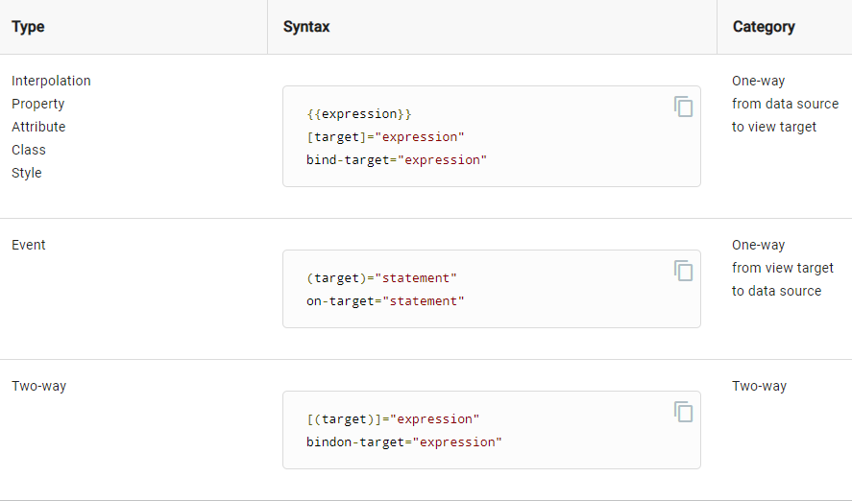
4. Data binding

Slide 24
4. Excercise Create Component & Databinding:
04_creating_component_and_databinding

Slide 25
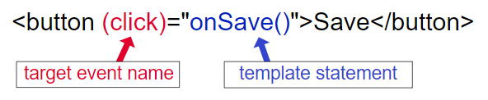
5. Event Binding

Slide 26

5. Event Binding

Slide 27
5. Excercise: Event Binding
05_event_binding

Slide 28
6. Output Events
Show MovieApp

Slide 29
6. Output Events
06_output_events

